Slide 1
"Psych students just can't code": CHALLENGE ACCEPTED
Rebecca Lai and Shannon McNee
@_R_Lai_
@ShannonMcNee2

Slide 2
So why do these gatekeepers, people who have the power (even if just 1% more than myself) to change undergraduate and graduate teaching, say "no to coding"? Why do they think the students in psychology just can't cope?
- Olivia Guest

Slide 3
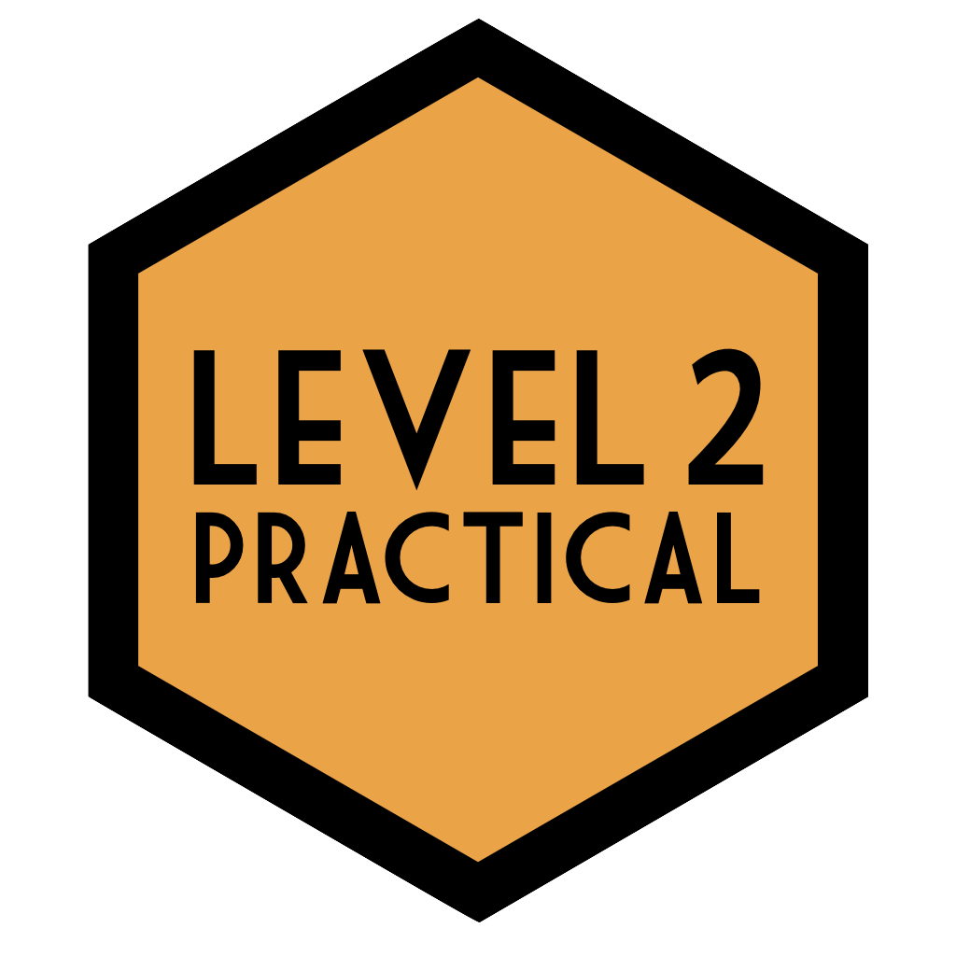
Outline
Motivations for learning R
Challenges and Successes
Moving from Taught to Teaching
Costs and Benefits

Slide 4
Motivations to transition from SPSS to R
Frustration with point and click nature of SPSS: "what's going on inside the 'black box'?"
Desire to challenge the limits of own existing knowledge
Competitive graduate attributes

Slide 5
Challenges
Any RED TEXT viewed as criticism rather than support
Language barrier: "I know what I want to say in English but I don't know how to tell R"
Googling it
Legitimate commands, nonsense output

Slide 6
Successes
Writing fully functioning scripts and R Markdown reports (with desired outputs!)
Producing beautiful, accessible data visualisations
Sense of ownership and independence
Empowered to be a part of the future of psychological science

Slide 7
From taught to “teaching”
Personal Experiences & Reflection
Teaching Practice
Continual Professional Development
Our experience informing our practice
Reflecting on what worked for us
Using these in our own practice
Still learning along the way!
Still developing new skills
Engaging with pedagogical literature

Slide 8
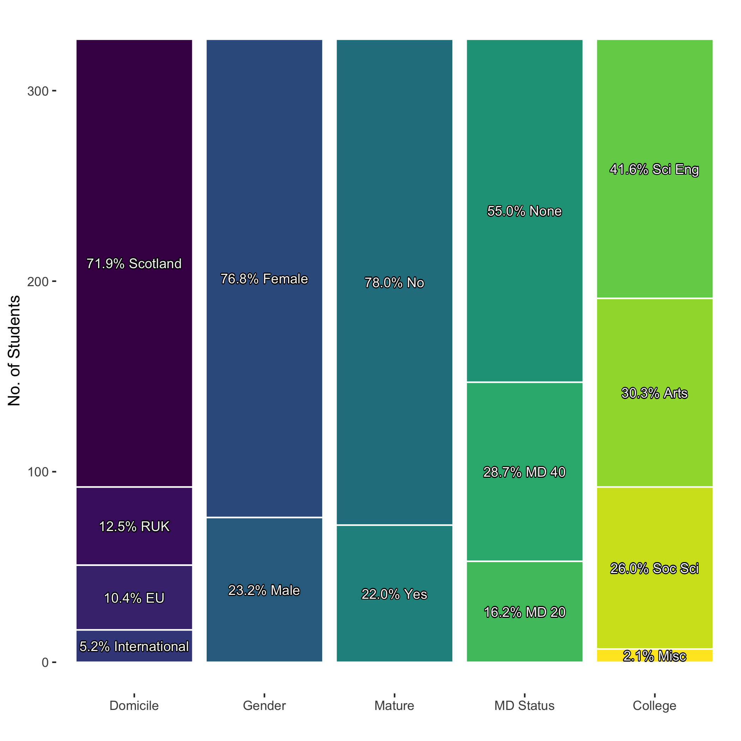
Not an Easy Task…
Diverse student population
Socialisation/Culture
Educational Histories
Expected Degree Path
Tight Scheduling
Set amount of material
Set amount of time
Large number of students

Slide 9
… but Very Possible
Strategies we used ourselves applied to our practice:
Reframing the RED text
“Talking through” the code
Developing search term literacy
Making predictions and testing them
Breaking the perfect, male geek trope
Mostly female TAs
Being visibly fallible

Slide 10
Teaching as a Learning Partnership
Nobody is an expert in all things
Learning new tools ourselves
Choosing appropriate tools and level of engagement
Engaging with pedagogical literature
Reflection on practice

Slide 11
Costs and Benefits
TAs may need extra support/training
Levelling up skills and reputation for all

Slide 12
In conclusion
We were the proof, and are continuing to prove, that you can teach undergraduates to code
Like any challenge you need to accept it and try before you can overcome it
The potential benefits outweigh the costs

Slide 13
Thank you for listening! Questions?
Rebecca Lai and Shannon McNee
@_R_Lai_
@ShannonMcNee2

